Slide 1

ECE 281 Lesson 22
Maj Jeffrey Falkinburg USAFA/DFEC
Room 2E46E 333-9193
1

Slide 2
Lesson 22 Outline
Do Time Logs!
CE4 – Elevator Control Due COB LSN 23!
Setup/Hold Time Constraints
Hold Time Violation
Clock Skew
Synchronizers

Slide 3
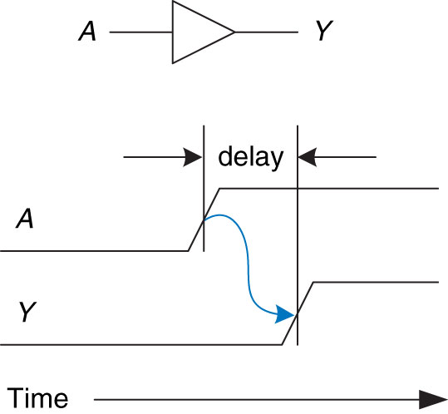
Delay
Figure 2.66 Circuit delay
Copyright © 2013 Elsevier Inc. All rights reserved.

Slide 4
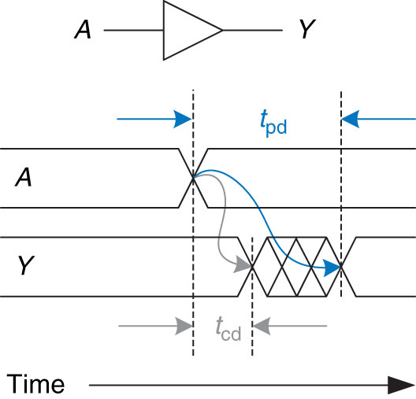
Propagation Delay and Contamination Delay
Figure 2.67 Propagation and contamination delay
Copyright © 2013 Elsevier Inc. All rights reserved.

Slide 5
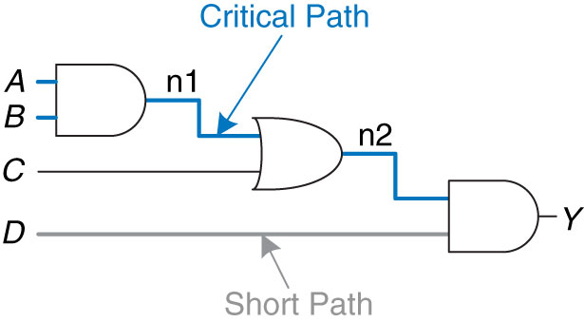
Critical Path and Shortest Path
Figure 2.68 Short path and critical path
Copyright © 2013 Elsevier Inc. All rights reserved.

Slide 6
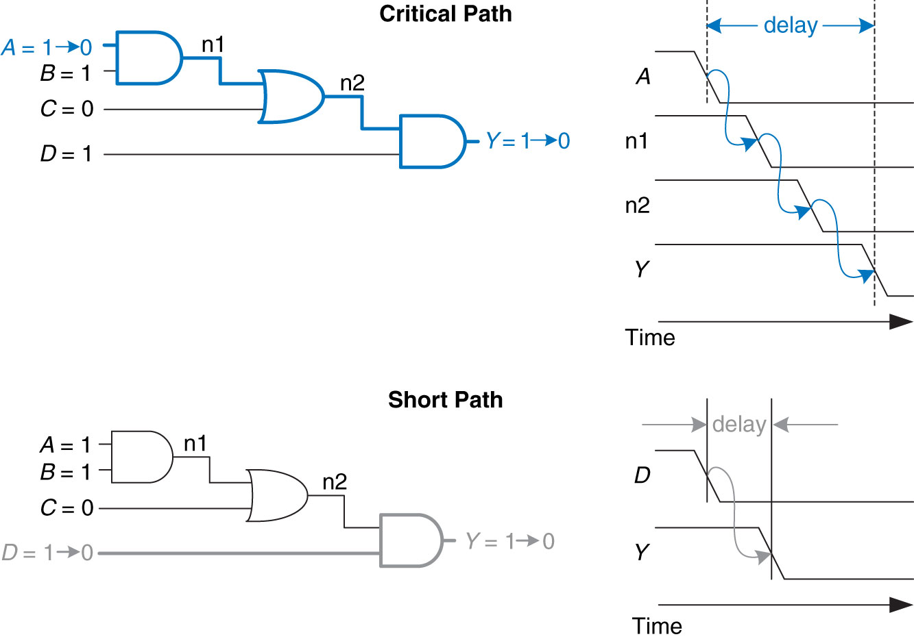
Critical Path and Shortest Path Waveform
Figure 2.69 Critical and short path waveforms
Copyright © 2013 Elsevier Inc. All rights reserved.
Copyright © 2013 Elsevier Inc. All rights reserved.

Slide 7
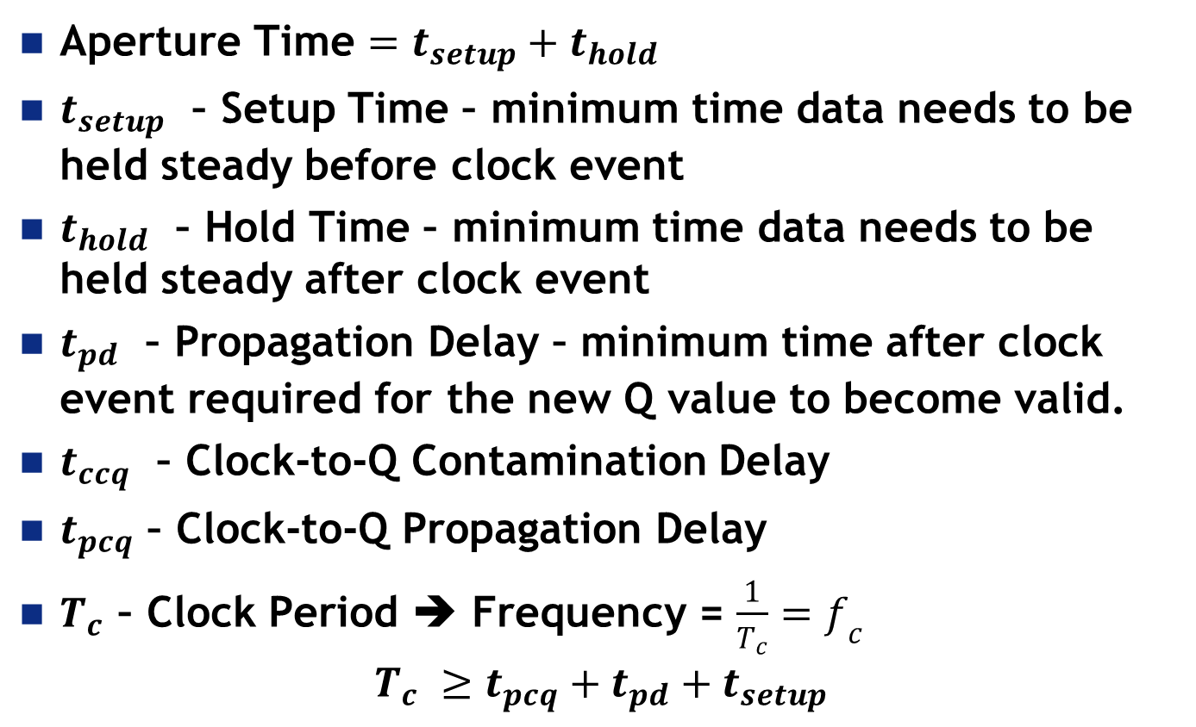
Timing Vocabulary and Equations
Aperture Time $=t_{setup}+t_{hold}$
$t_{setup}$ – Setup Time – minimum time data needs to be held steady before clock event
$t_{hold}$ – Hold Time – minimum time data needs to be held steady after clock event
$t_{pd}$ – Propagation Delay – minimum time after clock event required for the new Q value to become valid.
$t_{ccq}$ – Clock-to-Q Contamination Delay
$t_{pcq}$ – Clock-to-Q Propagation Delay
$T_{c}$ – Clock Period ➔ Frequency = $\frac{1}{T_{c}}=f_{c}$
$$T_{c} ≥t_{pcq}+t_{pd}+t_{setup}$$

Slide 8
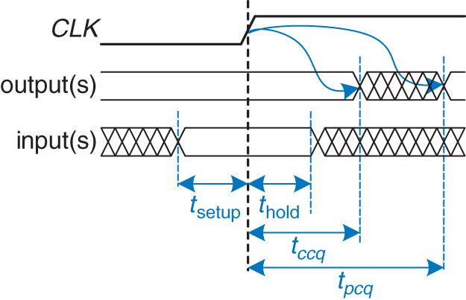
Timing Specification for Synchronous Circuits
Figure 3.37 Timing specification for synchronous sequential circuit
Copyright © 2013 Elsevier Inc. All rights reserved.

Slide 9
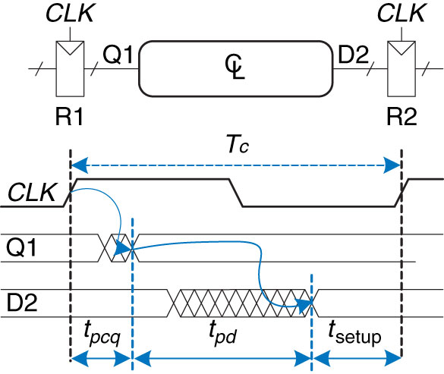
Time Clock to Q
Propagation Delay
Figure 3.39 Maximum delay for setup time constraint

Slide 10
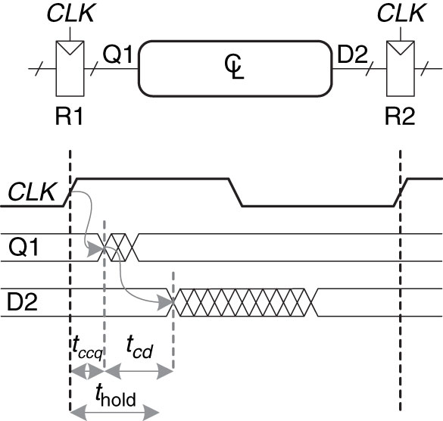
Time Clock to Q
Contamination Delay
Figure 3.40 Minimum delay for hold time constraint
Copyright © 2013 Elsevier Inc. All rights reserved.

Slide 11

Setup/Hold Time Constraints
Given:
$$T_{c} ≥t_{pcq}+t_{pd}+t_{setup}$$
Hold Time Constraints:
$$t_{cd} ≥t_{hold}−t_{ccq}$$
Setup Time Constraints:
$$t_{pd} ≥T_{c}−\left(t_{pcq}+t_{setup}\right)$$
Sequencing Overhead

Slide 12
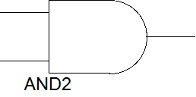
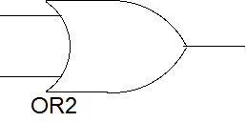
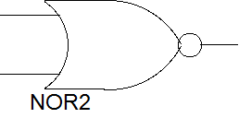


Example 3.10 –Timing Analysis
CLK
A
N1
CLK
X*
X
B
C
Y*
Y
Given Flip-Flops:
$$t_{ccq}=30ps$$
$$t_{pcq}=80ps$$
$$t_{setup}=50ps$$
$$t_{hold}=60ps$$
Given Combo Logic:
$$t_{pd}=40ps$$
$$t_{cd}=25ps$$
D
1. Determine Maximum clock frequency and whether any hold time violations occur

Slide 13
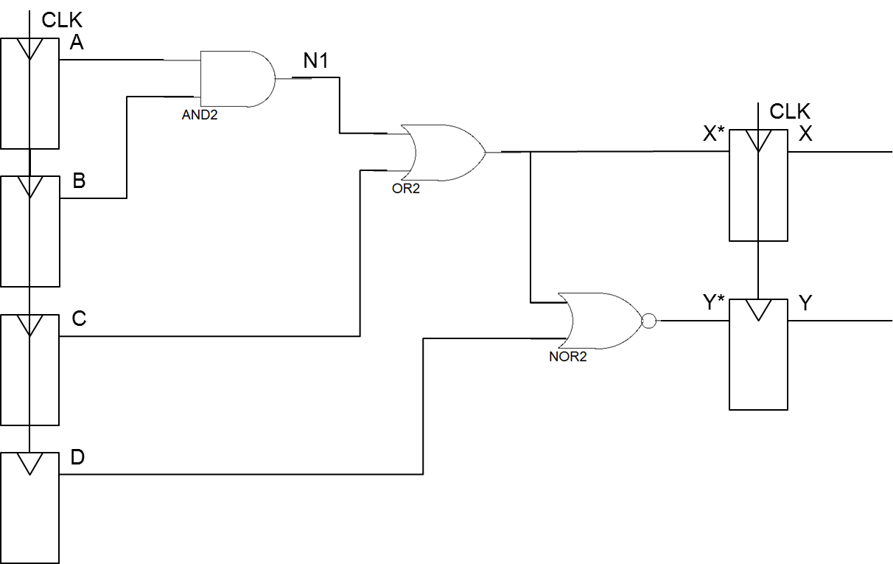
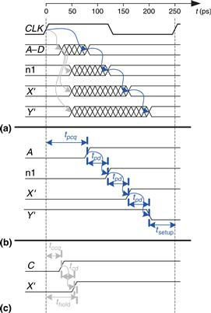


Example 3.10 –Timing Analysis
Find max clock frequency?
Critical Path
$T_{c} ≥t_{pcq}+3∙t_{pd}+t_{setup}$
min $T_{c} ≥80+3∙40+50$ = 250ps
max $f_{c}=\frac{1}{T_{c}}=\frac{1}{250ps}=$
0→1
0
0→1
0→1
1
1→0
0
0
$$4 GHz$$
Figure 3.43 Timing diagram: (a) general case, (b) critical path,
(c) short path

Slide 14


Example 3.10 –Timing Analysis
Hold time violation occur?
Shortest Path
$Shortest Path=t_{ccq}+t_{cd}$
$Shortest Path=30+25=55ps$
We assumed $t_{hold}=60ps$ (i.e. hold time violation)
0
0
0→1
1
1→0
0→1
could add buffers to fix Hold Time violation
0
Figure 3.43 Timing diagram: (a) general case, (b) critical path,
(c) short path

Slide 15
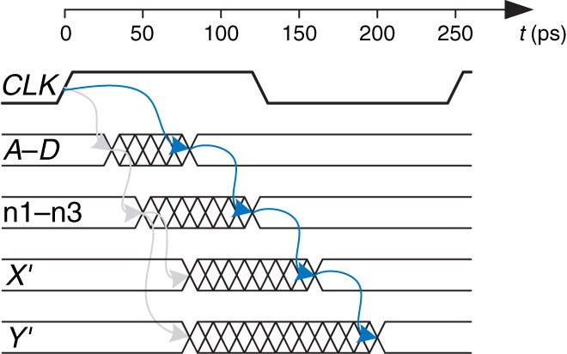

Example 3.10 –Timing Analysis
Fix hold time violation
Add Buffers to Shortest Path
$Shortest Path=t_{ccq}+2∙t_{cd}$
$Shortest Path=30+2∙25=80ps$
could add buffers to fix Hold Time violation
Figure 3.45 Timing diagram with buffers to fix hold time problem

Slide 16
Timing Diagram with Buffers to fix Hold Time Problem
Figure 3.45 Timing diagram with buffers to fix hold time problem
Copyright © 2013 Elsevier Inc. All rights reserved.

Slide 17
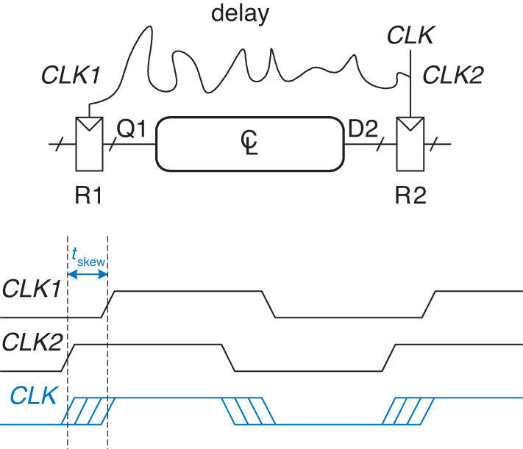
Clock Skew
Figure 3.46 Clock skew caused by wire delay
Copyright © 2013 Elsevier Inc. All rights reserved.

Slide 18
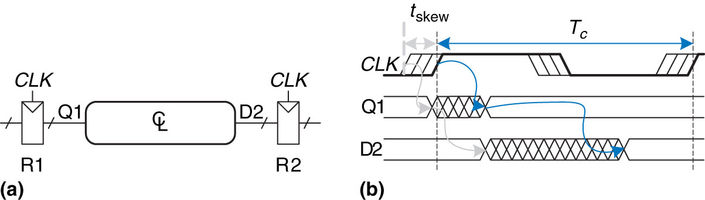

Clock Skew - Timing
Timing with Clock Skew:
$$T_{c} ≥t_{pcq}+t_{pd}+t_{setup}+t_{skew}$$
Figure 3.47 Timing diagram with clock skew
Copyright © 2013 Elsevier Inc. All rights reserved.

Slide 19
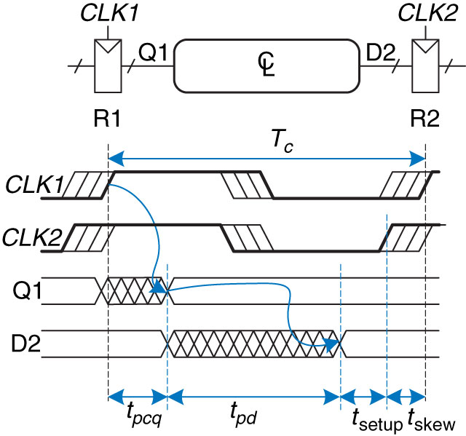

Clock Skew – Setup Time
Setup Time Constraints with Skew :
$$t_{pd} ≥T_{c}−\left(t_{pcq}+t_{setup}+t_{skew}\right)$$
Figure 3.48 Setup time constraint with clock skew
Copyright © 2013 Elsevier Inc. All rights reserved.

Slide 20
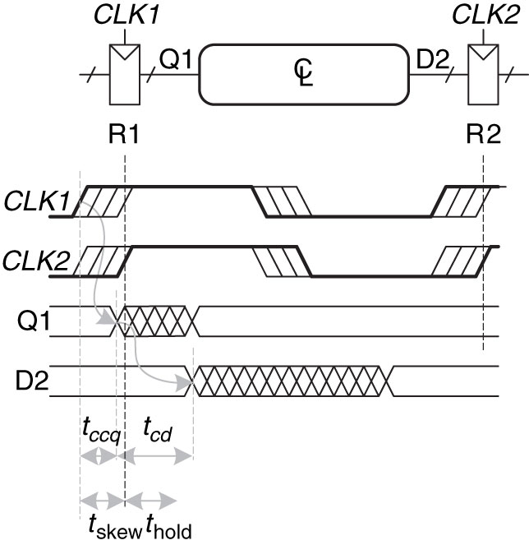

Clock Skew – Hold Time
Hold Time Constraints with Skew:
$$t_{cd} ≥t_{hold}+t_{skew}−t_{ccq}$$
Figure 3.49 Hold time constraint with clock skew
Copyright © 2013 Elsevier Inc. All rights reserved.

Slide 21
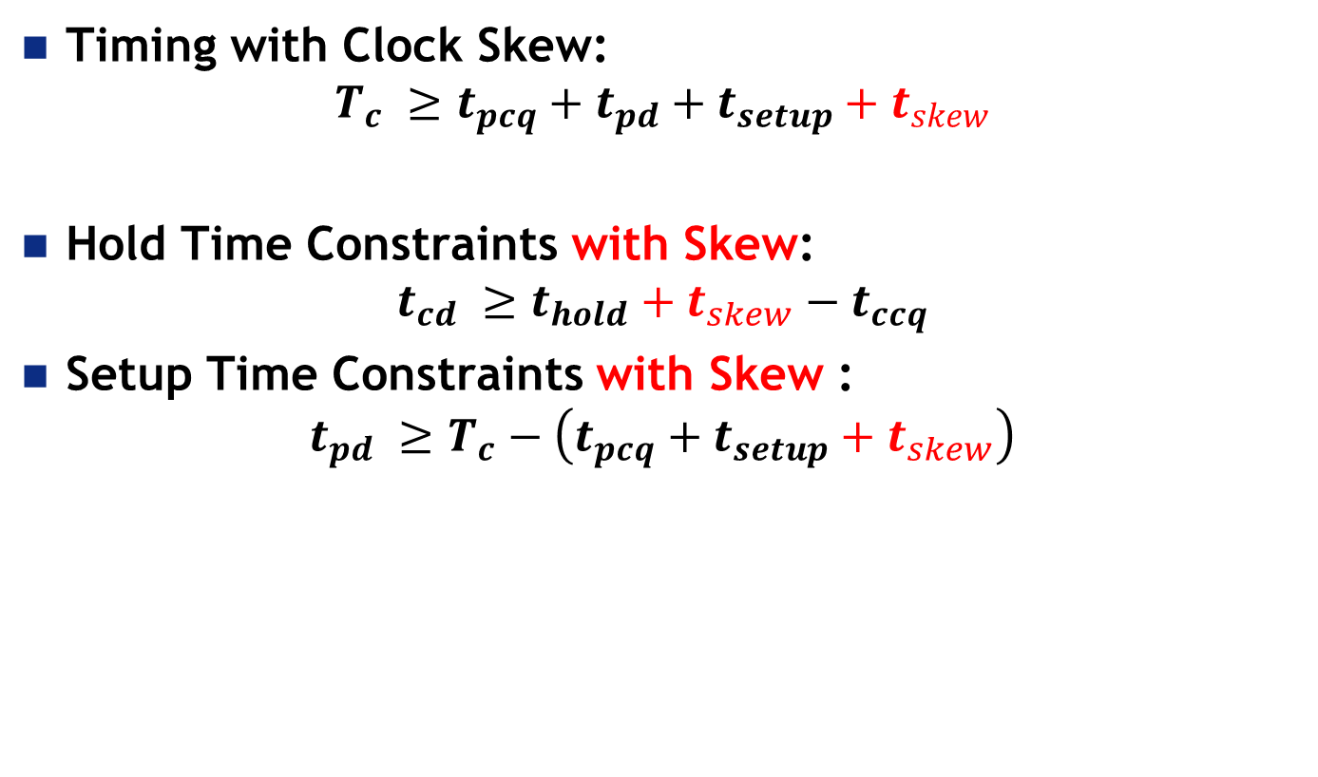
Clock Skew - Summary
Timing with Clock Skew:
$$T_{c} ≥t_{pcq}+t_{pd}+t_{setup}+t_{skew}$$
Hold Time Constraints with Skew:
$$t_{cd} ≥t_{hold}+t_{skew}−t_{ccq}$$
Setup Time Constraints with Skew :
$$t_{pd} ≥T_{c}−\left(t_{pcq}+t_{setup}+t_{skew}\right)$$
Sequencing Overhead

Slide 22

Example 3.10 –Timing Analysis with clock skew
CLK
A
N1
CLK
X*
X
B
C
Y*
Y
Given Flip-Flops:
$$t_{ccq}=30ps$$
$$t_{pcq}=80ps$$
$$t_{setup}=50ps$$
$$t_{hold}=60ps$$
Given Combo Logic:
$$t_{pd}=40ps$$
$$t_{cd}=25ps$$
Assuming:
$$t_{skew}=50ps$$
D

Slide 23


Example 3.10 –Timing Analysis with clock skew
Find max clock frequency?
Critical Path
$T_{c} ≥t_{pcq}+3∙t_{pd}+t_{setup}+t_{skew}$
${min T}_{c} ≥80+3∙40+50+50$ = 300ps
max $f_{c}=\frac{1}{T_{c}}=\frac{1}{250ps}=$
$$3.3 GHz$$
Figure 3.43 Timing diagram: (a) general case, (b) critical path,
(c) short path

Slide 24
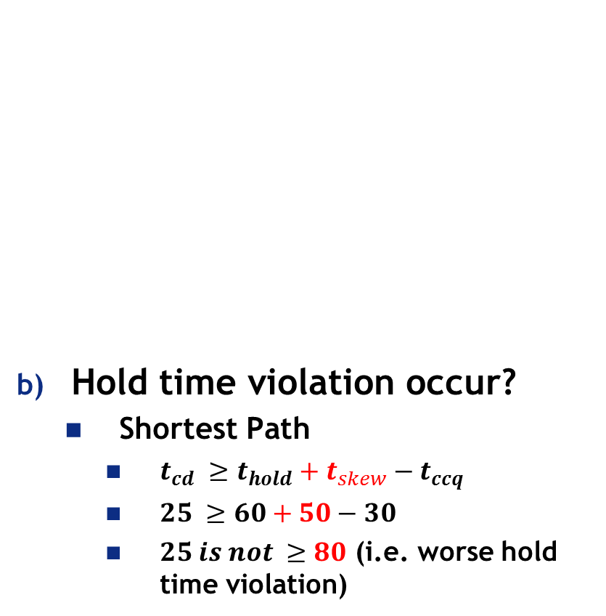
Example 3.10 –Timing Analysis with clock skew
Hold time violation occur?
Shortest Path
$t_{cd} ≥t_{hold}+t_{skew}−t_{ccq}$
$25 ≥60+50−30$
$25 is not ≥80$ (i.e. worse hold time violation)
could add buffers to fix Hold Time violation
Figure 3.43 Timing diagram: (a) general case, (b) critical path,
(c) short path

Slide 25
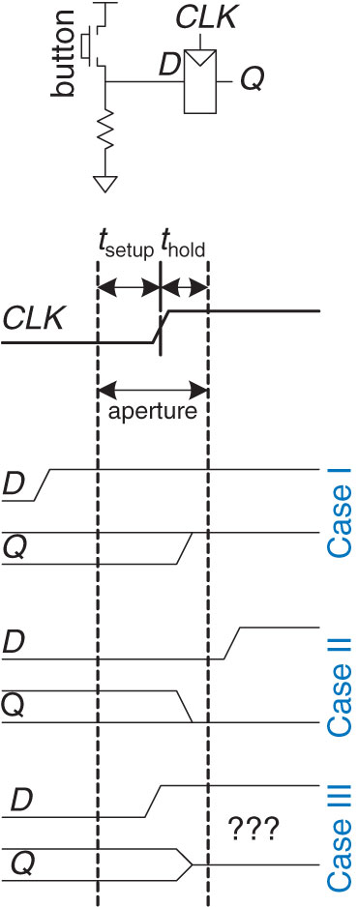
Aperture
Figure 3.50 Input changing before, after, or during aperture
Copyright © 2013 Elsevier Inc. All rights reserved.

Slide 26
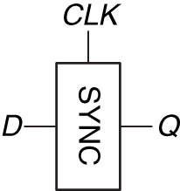

Synchronizers
Slows down inputs and gives them time to settle/stabilize – Resolution Time ($t_{res}$)
$$t_{res} >T_{c}−t_{setup}$$
To guarantee good logic levels all asynchronous inputs should be passed through synchronizers
Figure 3.52 Synchronizer symbol

Slide 27
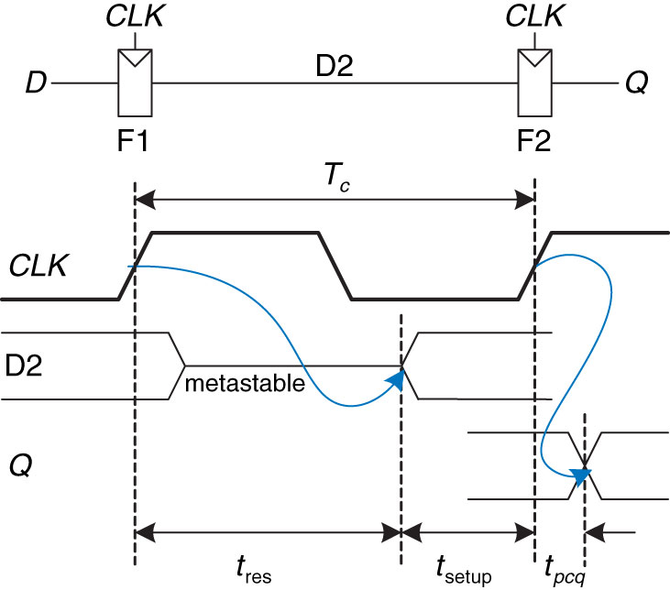
Synchronizers
Figure 3.53 Simple synchronizer
Copyright © 2013 Elsevier Inc. All rights reserved.

Slide 28
Extra Instruction (EI)
Maj Jeffrey Falkinburg
2E46E
Office: 333-9193
M1
ECE 281 – 2F44
T1
M2
ECE 281 – 2F44
T2
M3
ECE 463 – 2G2
T3
ECE 383 – 2E48A
M4
ECE 463 – 2G2
T4
ECE 383 – 2E48A
Available
M5
T5
Sometimes Available
M6
ECE 383 – 2E48A
T6
Always Unavailable
M7
ECE 383 – 2E48A
T7

Slide 29

29

